Slide 1
Transportation &
Logistics Systems
Session 3
Inventory Management – III:
Risk Pooling & Warehousing
January 22, 2019

Slide 2
Announcements
HW 2 due now
HW 3 (HP) due Jan 29
  See syllabus for questions
  Answer all questions explicitly
  Team effort
HW 1 Graded
You did well☺
  Average: 143.48
  Median: 145
  SD: 9.95
What is a good start date for take-home final exam?
  Start: 12:01AM, Feb 7; end 11:59PM, Feb 13
  Test will be available in Bb (“Exam” folder)

Slide 3
Lecture Outline
SC Inventory Computations
Risk Pooling
Intro to Warehousing
Warehouse Technology
Intro to transportation (time permitting)
Summary

Slide 4
Inventory policy
at a location
(e.g. at a DC)
Supplier
ASIC
US DC
Retailer
Customer
Supplier
PC
Board
FAT
Euro DC
Retailer
Customer
Supplier
Subassembly
Far East DC
Supplier
Retailer
Customer
You are the manger of
this facility. What is your
optimal inventory policy?
Need right inventory
model that tells you
when & how much to
order
What is the
right model?
Inventory Modeling
Approaches
Finding total
inventory in a
supply Chain
Supplier
Manufacturer
Distributor
Retailer
Customers
What is the total
inventory in this SC?
Depends on inventory policies at stocking
locations. Total SC inventory = CS + SS + PS

Slide 5
Total SC Inventory Computation
Suppliers
Manufacturers
Distributors
Retailers
Customers
Different types of inventory
  Cycle Stock (CS)
  Safety Stock (SS)
  Pipeline Stock (PS)
  Work in process (WIP) inventory
  Raw material inventory
Shelf Inventory
Total SC Inventory = CS + SS + PS

Slide 6


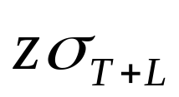

Total SC Inventory Computation
Transportation pipeline
Leadtime = L
Shelf Inventory
Orders
Demand
Q
D,
Pipeline Stock
Pipeline Stock = L
Safety Stock =
( z = no. of SD for reqd. for given SL or FR)
Cycle Stock = Q/2 (for continuous review)
= (T/2) (for periodic review)
Total SC Inventory = CS + SS + PS
Notes:
7

Slide 7
In-class exercise…
703 Distribution Company

Slide 8
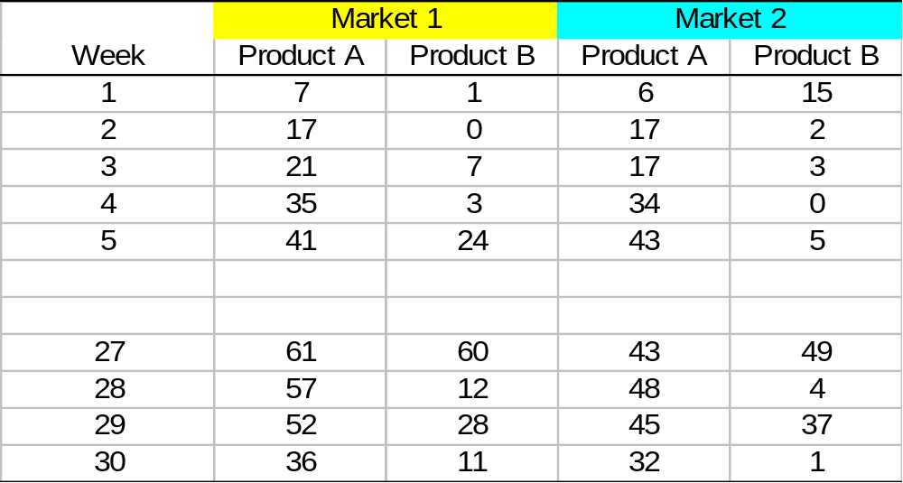
Example: 703 Distribution Company
1
w1
M1
M1
2 products, 2 markets
SL = 97%
L = 1week, T = 1week
S
S
W
w2
M2
2
M2
Which of the two
SCs is preferable
from an inventory
Perspective?

Slide 9
Lecture Outline
SC Inventory Computations
Risk Pooling
Intro to Warehousing
Warehouse Technology
Intro to transportation (time permitting)
Summary

Slide 10
Risk Pooling
Consider the following two systems
Warehouse 1
Market 1
Supplier
Warehouse 2
Market 2
Market 1
Supplier
Warehouse
Market 2

Slide 11

Risk Pooling
For the same service level, which system will require more inventory? Why?
For the same total inventory level, which system will have better service? Why?
What are the factors that affect these answers?

Slide 12
Important Observations
Centralizing inventory control reduces safety stock level for the same service level.
This works best for
  High coefficient of variation, which reduces required safety stock.
  Negatively correlated demand. Why?

Slide 13

To Centralize or not to Centralize
What is the effect on:
  Safety stock?
  Service level?
  Overhead?
  Lead time?
  Transportation costs?

Slide 14
Applications of Risk Pooling
Component commonality (Ford, GM)
The Gap (& Old Navy): centralized inventory for non-standard sizes
Postponement or delayed differentiation

Slide 15
Lecture Outline
SC Inventory Computations
Risk Pooling
Intro to Warehousing
Warehouse Technology
Intro to transportation (time permitting)
Summary

Slide 16
Warehousing
Reasons for storage
Transportation and production costs can be reduced
Better coordination of supply and demand
Storage can be an integral part of the production process
Storage may enhance sales, reduce purchase cost
Storage Functions
Holding
Consolidation (merge-in-transit)
Break-bulk or mixing

Slide 17
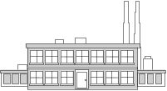



Warehouse Functions
Holding
10,000 lb.
A
Manufacturer A
Consolidation
(merge in transit)
8,000 lb.
B
Manufacturer B
40,000 lb.
A
B
C
D
15,000 lb.
C
Consolidation warehouse
Customer
Manufacturer C
Break-bulk
(mixing)
7,000 lb.
D
Manufacturer D

Slide 18
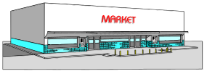
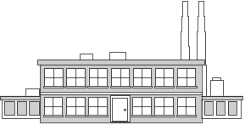

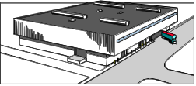
Warehouse Functions
Holding
LTL
Customer A
Consolidation
(merge in transit)
LTL
Manufacturer
Low rate TL shipment
Distribution warehouse
Customer B
LTL
Break-bulk
(mixing)
Customer C

Slide 19
Warehousing Decisions
Where, how many, demand allocation
Strategy (size, layout, material handling, etc.)
Type of need (holding, cross-dock, mix)
Information system/technology
Product characteristics/mix

Slide 20
Controlling Costs
Handling is typically a labor intensive activity
Costs are decreased by
  Reducing distance traveled
  Increasing number of units handled at one time
  Seeking multiple order picking in a single round trip
  Increasing storage density
Cost reduction is also achieved by
  Carefully planning the physical layout of the building
  Carefully locating the items within the order-picking area
  Using technology, automation, etc.

Slide 21
Warehouse layout

Slide 22
Warehouse Layout
Fundamentals
Location of receiving & shipping
Aisle configuration
Stack height

Slide 23
W/H Layout Fundamentals
Variable Costs:
Accurately estimated by the forklift movement time
  receiving to storage to shipping
  differences in insertion/extraction times are small
Movement time is proportional to distance
Principle: store fast moving SKUs in the most convenient locations
Issues: what is fast moving & what is convenient
Average visits per
storage location
# of units shipped
Fast moving:
=
# per storage unit
(e.g. pallet or box)

Slide 24
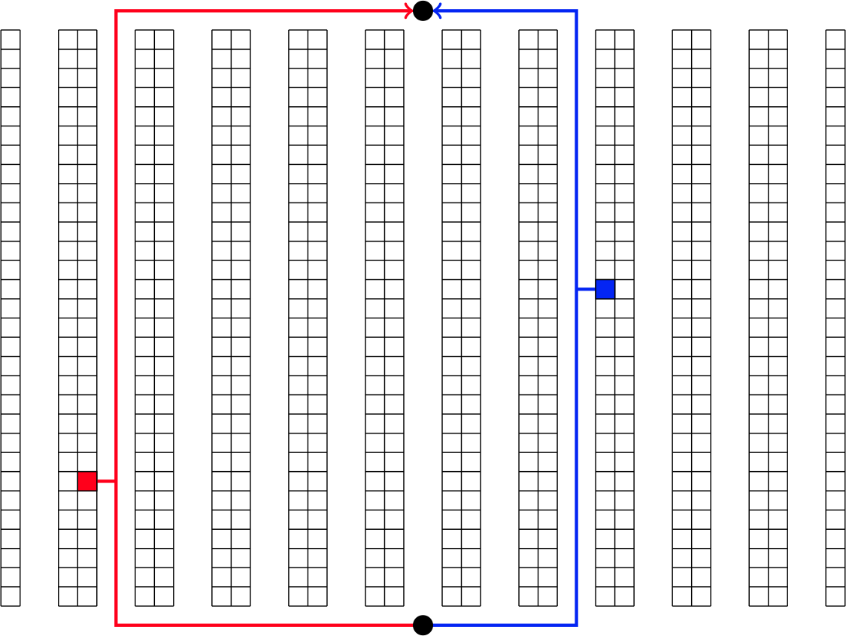
What is Convenient?
SHIPPING
Average location
is the midpoint
Blue better than red
RECEIVING

Slide 25
Layout Principle
Principle: fast moving SKUs should be stored in the
most convenient locations
Average visits per
storage location
# of units shipped
=
# per storage unit
(e.g. pallet or box)
Rank all storage locations (pallet positions) from lowest to highest cost
Rank all SKUs from most to least turns (fastest to slowest)
Move down the list to match SKUs to locations
  Match SKU with highest turn to lowest cost loc.

Slide 26
Warehouse Layout
Fundamentals
Location of receiving & shipping
Aisle configuration
Stack height

Slide 27
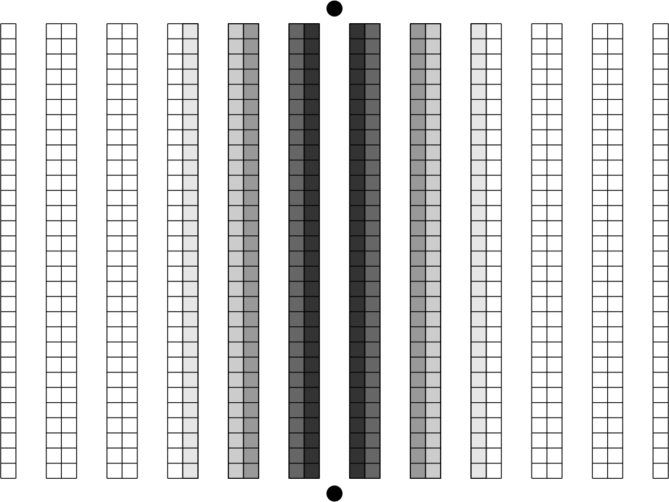
Flow through Configuration
SHIPPING
All locations on
one side of aisle
are equal
What happens if
both shipping &
receiving are moved
to one side?
System….
STRICTLY WORSE
RECEIVING

Slide 28
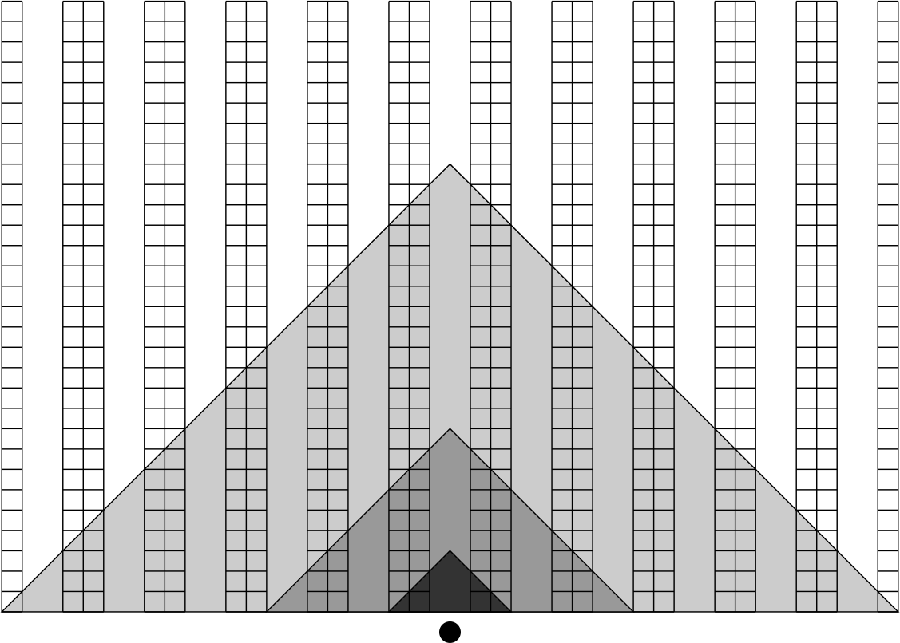
U-flow Configuration
Most convenient
Only a few such
locations
NOT convenient
SHIPPING & RECEIVING

Slide 29
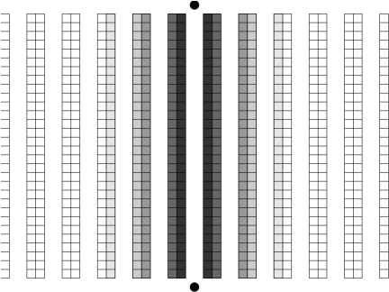
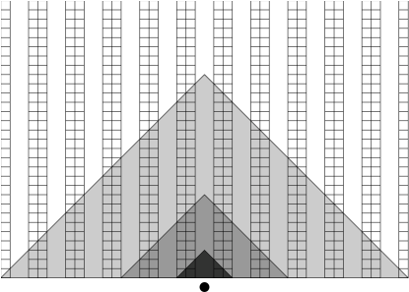
Flow through vs. U-flow Configurations
FLOW THROUGH
U-FLOW
Shipping & receiving on
opposite sides
Shipping & receiving on
the same side
Many locations of equal
convenience
Flexibility in shipping & receiving
Makes a few locations
VERY convenient
Less interference in movements
Appropriate when only a few
SKUs are high volume, and
many slow-moving SKUS
Appropriate for high volume

Slide 30
Warehouse Layout
Fundamentals
Location of receiving & shipping
Aisle configuration
Stack height

Slide 31
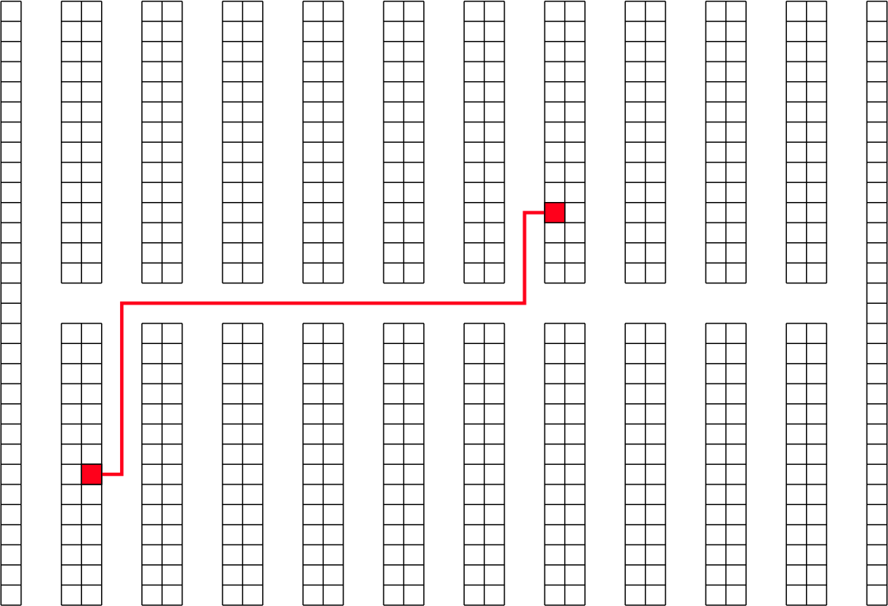
Cross Aisles
Allows more direct travel between storage locations
Useful for dual-cycle forklift operations (need coordination/IT)

Slide 32
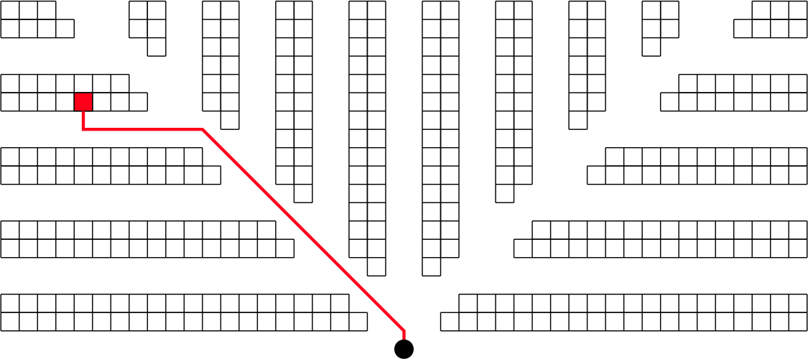
Angled Aisles
Allows more direct travel between storage and a central location
May reduce travel by up to 20% (Gue & Miller, 2008)

Slide 33

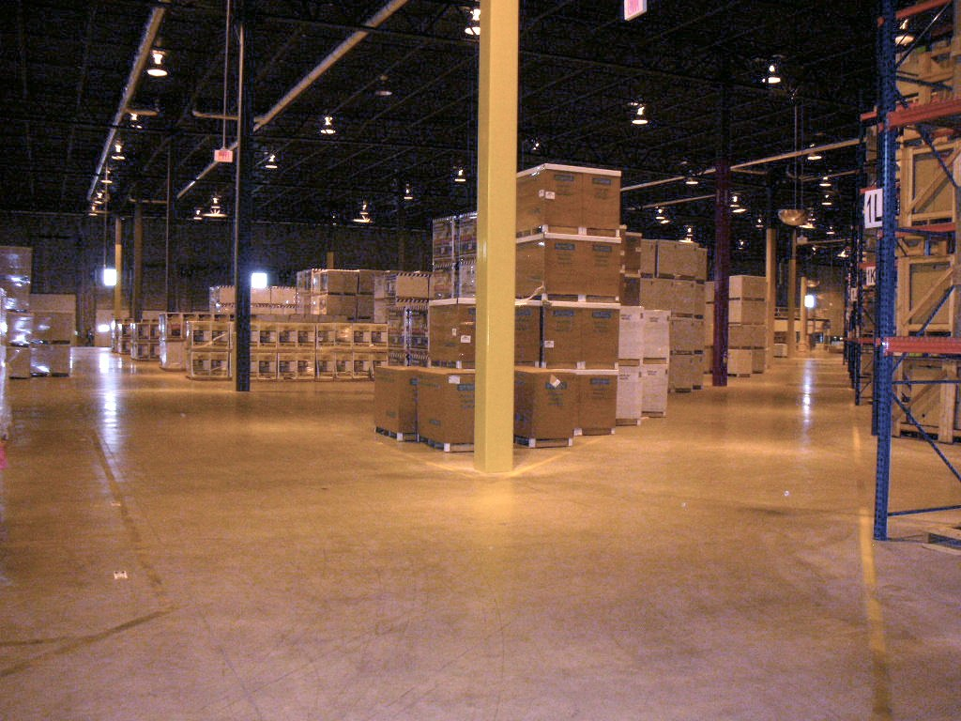
Example: Angled Aisles
Generac Power Systems, Whitewater, WI
Photo curtsey: Prof. Kevin Gue, Auburn University

Slide 34
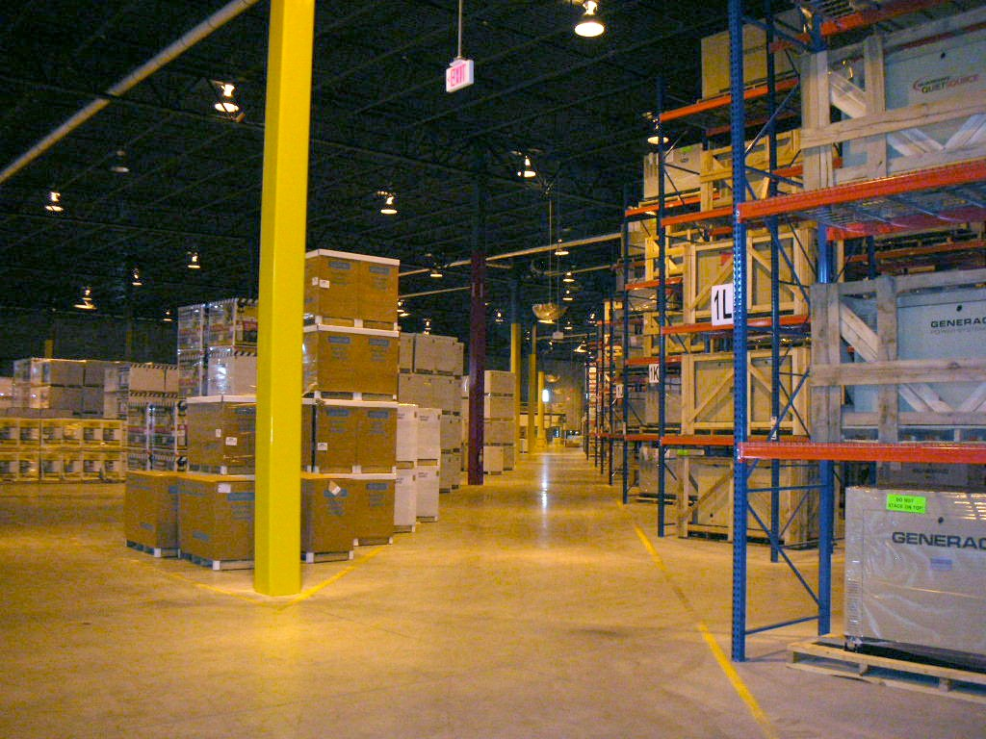
Example: Angled Aisles
Generac Power Systems, Whitewater, WI
Photo curtsey: Prof. Kevin Gue, Auburn University

Slide 35
Warehouse Layout
Fundamentals
Location of receiving & shipping
Aisle configuration
Stack height

Slide 36
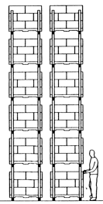
Stack Height
PROS
Creates additional pallet positions
(opportunity for additional revenue)
Might reduce labor cost (easy storage & retrieval)
CONS
Need to justify investment in pallet racks
Hard for fragile SKUs, uneven surface
Constraint: building/ceiling height

Slide 37
Warehouse Layout
Fundamentals
Location of receiving & shipping
Aisle configuration
Stack height

Slide 38
Lecture Outline
SC Inventory Computations
Risk Pooling
Intro to Warehousing
Warehouse Technology
Intro to transportation (time permitting)
Summary

Slide 39
Warehouse Technology
Bar Codes
RFID

Slide 40
Barcode: How it Works
Input device (scanner) converts light energy to electrical energy
  High wattage light bulbs initially used
  Lasers are now the norm
Decoder converts electronic signal into data
  Automatically differentiates between barcode types
Computer system retrieves product information from database

Slide 41
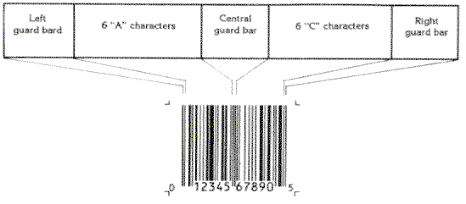
How It Works
Left, right, center guard bars align and verify signal
Leftmost number is Universal Product Code (UPC) type
Next five digits represent manufacturer code
Followed by five digit product code
Final digit is an integrity check

Slide 42
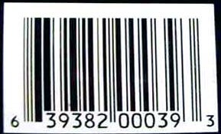
Integrity Check
1. Add together the value of all of the digits
in odd positions (digits 1, 3, 5, 7, 9 and 11).
6 + 9 + 8 + 0 + 0 + 9 = 32
2. Multiply that number by 3.
32 * 3 = 96
3. Add together the value of all of the digits
in even positions (digits 2, 4, 6, 8 and 10).
3 + 3 + 2 + 0 + 3 = 11
4. Add this sum to the value in step 2.
96 + 11 = 107
5. Take the number in Step 4. To create the check digit, determine the number
that, when added to the number in step 4, is a multiple of 10.
107 + 3 = 110. The check digit is therefore 3.

Slide 43
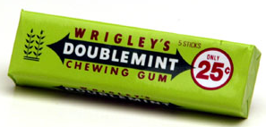
Business Issues
Advantages
Cost effective
Infrastructure already in place within most industries
Established technological standards
Still effective in most industries
Disadvantages
No inventory tracking
Read-only
Labor costs for scanning
What is the first product
sold with bar code?
Impact (Source: PWC Research, 2002)
Prices would have risen twice as fast
Savings are 45 times larger than initially thought
June 1974, Troy, OH

Slide 44
Warehouse Technology
Bar Codes
RFID

Slide 45
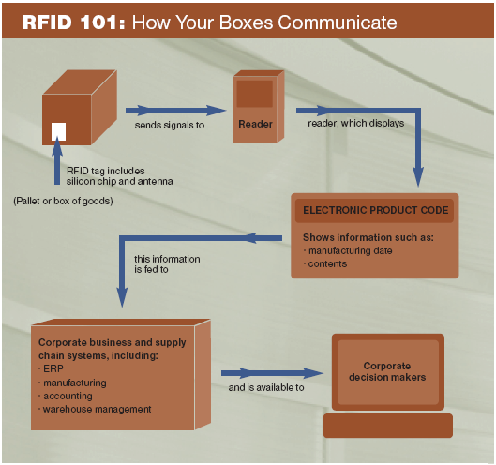
What is RFID?
Notes:
45
Reference
0416_supplychain.pdf → p. 8

Slide 46

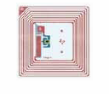
RFID vs. Barcode
Barcode Labels | RFID Tags
Limited read range | Longer read range
A line of sight required | No line of sight required
Limited and static data | More and changeable data
Low operational awareness & supply chain visibility | High operational awareness & supply chain visibility
Work with virtually all products | Physical limitation (metals and liquids)
Simple to apply | Complex to implement
Inexpensive | Expensive

Slide 47



RFID Benefits
SC Benefits
Visibility
Tracking
Monitoring
Better forecasting
Better inventory mgmt.
Labor savings
Product recall easier
Product Flow
Information Exchange
Supplier
Distribution
Center
Retail Store

Slide 48
Example….
RFID Implementation
at Wal-Mart
Notes:
48

Slide 49
RFID at WMT (2005)
Approx. 68,000 suppliers, >50 million pallets shipped every week
Required its top 100 suppliers to use RFID technology, by Jan 2005
Suppliers responsible for their own infrastructure costs!
By the end of 2005, over 600 stores and clubs and 12 distribution centers live with RFID
Cooperation of suppliers in Wal-Mart’s pilot distribution centers in TX
  P&G, Unilever, Johnson & Johnson, Nestle, Kraft, and Gillette
End-2006 target: next 200 suppliers, 1000 stores

Slide 50
Estimated Savings (2005)
Est. Annual Cost Savings | Detail Benefits
$6.7 Billion | Reduces labor costs by 15 percent
$600 Million | Smart shelves to monitor on-shelf availability
$575 Million | Automatically Reduces administrative error and vendor fraud
$300 Million | Better tracking of over 1 billion pallets and cases that move through its distribution centers
$180 Million | Improved visibility of product location to reduce inventory carrying cost
$8.35 Billion | Total pre-tax savings
Source: Analysis: Ziff Davis Media Inc. RFID - Wal-Mart's Network Effect By Mark Roberti, eWeek
Notes:
50

Slide 51

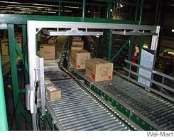
RFID at WMT (2007)
Scaled down. RFID at 5 DCs and 1000 stores as of Feb 2007 (Original proposal: 12 DCs by Jan 2006)
Tags to Cases and pallets only
Tests using tags aren't showing any $ savings! However..
  Product availability at stores have improved
  More efficient replenishment process
Suppliers story
  RFID tagging takes more labor
  Will be years to see any ROI, if at all
Similar results at TGT, BBY, Albertson’s
Source: The Wall Street Journal, Feb 15, 2007

Slide 52
RFID at WMT (2010)
Has started subsidizing suppliers
Pilot for item-level tagging underway
Still very enthusiastic about the technology
Source: The Wall Street Journal, July 23, 2010

Slide 53
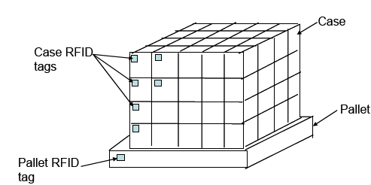
Case- vs. Pallet-Level Tagging

Slide 54
Potential improvements in
in-store logistics
Problem | Improve with pallet-level tagging? | Improve with case-level tagging? | Improve with item-level tagging?
Product in backroom, not on selling floor | NO | YES | YES
Product on wrong place on floor | NO | NO | YES
Promotion non-compliance | NO | YES | YES
Checkout scan problem | NO | NO | YES
Obsolete product not removed/returned | NO | NO | YES
Receiving problems | NO | YES | YES

Slide 55
Back to Wal-Mart Example….
Item-level tagging
at Wal-Mart

Slide 56

Source: The Wall Street Journal, July 23, 2010

Slide 57
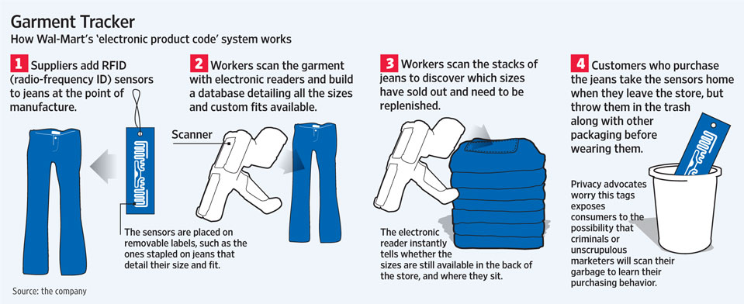
Source: The Wall Street Journal, July 23, 2010

Slide 58
Warehouse Technology
Bar Codes
RFID

Slide 59
Lecture Outline
SC Inventory Computations
Risk Pooling
Intro to Warehousing
Warehouse Technology
Intro to transportation (time permitting)
Summary

Slide 60
Introduction
Movement of product from one location to another
Products rarely produced and consumed in the same location
Significant cost component
Shipper requires the movement of the product
Carrier moves or transports the product

Slide 61
Transportation Modes
Trucks
Rail
Air
Package Carriers
Water
Pipeline
Notes:
61
Notes:

Slide 62
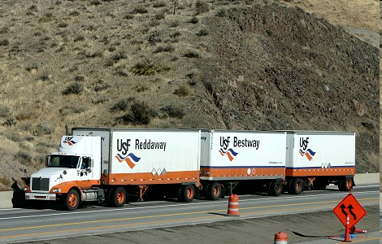
Trucks
Accounts for 75% of freight bill in the US
Major players: Schneider National, JB Hunt, Ryder
TL
LTL
Average revenue per ton-mile (2013) = 9.13 cents
Average haul = 274 miles
Low fixed and variable costs
Major Issues
  Utilization
  Consistent service
  Backhauls
Average revenue per ton-mile (2013) = 16.54 cents
Average haul = 646 miles
Higher fixed costs, low variable costs
Major Issues
  Location of consolidation facilities
  Utilization
  Vehicle routing
  Customer service
Notes:
62
Notes:

Slide 63

Transportation Modes
Trucks
Rail
Air
Package Carriers
Water
Pipeline
Notes:
63
Notes:

Slide 64
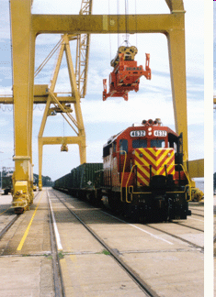
Rail
Average revenue / ton-mile (2013) = 4.05 cents
Average haul = 720 miles
Average load = 80 tons
Major Players: CSX, CN, BNSF
Key Issues
  Scheduling to minimize delays / improve service
  Off track delays (at pick up and delivery end)
  Variability of delivery times
Notes:
64
Notes:

Slide 65
Transportation Modes
Trucks
Rail
Air
Package Carriers
Water
Pipeline
Notes:
65
Notes:

Slide 66
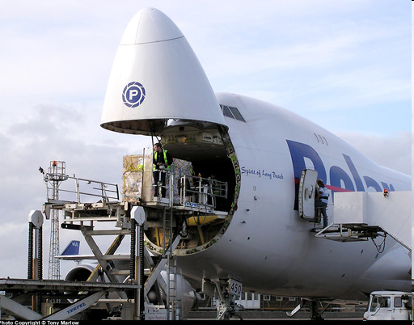
Air
Fast and expensive
Small, high value items, light weight (Ex. Tech)
Key Issues
  Location/Number of hubs
  Location of fleet bases / crew bases
  Schedule optimization
  Fleet assignment
  Crew scheduling
  Revenue management
Notes:
66
Notes:

Slide 67
Transportation Modes
Trucks
Rail
Air
Package Carriers
Water
Pipeline
Notes:
67
Notes:

Slide 68
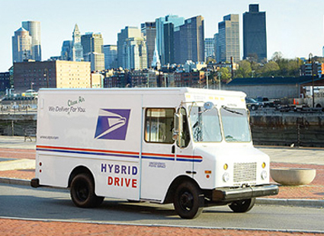
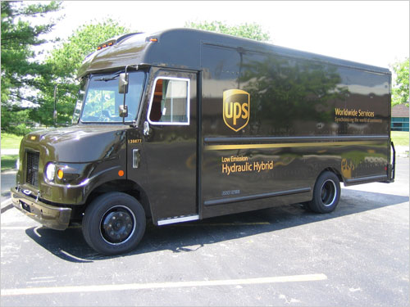

Package Carrier
Different service classes
Low vol., light weight items,
Key Issues
  Location/Number of hubs
  Location of fleet bases
  Vehicle routing
  Crew scheduling
  Managing different service classes
  First and last mile

Slide 69
Transportation Modes
Trucks
Rail
Air
Package Carriers
Water
Pipeline
Notes:
69
Notes:

Slide 70
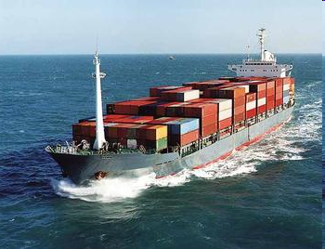
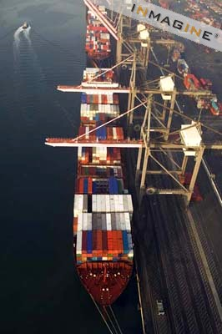
Water
Chief enabler of global trade
Used when no land route available
Very high vol., heavy items
Low cost
Minimal pollution
50,000 commercial vessels, flags from over 150 countries
Global tonnage: 8.9 Billion tons (2011)
Data Source: Fortune, May 21, 2012

Slide 71
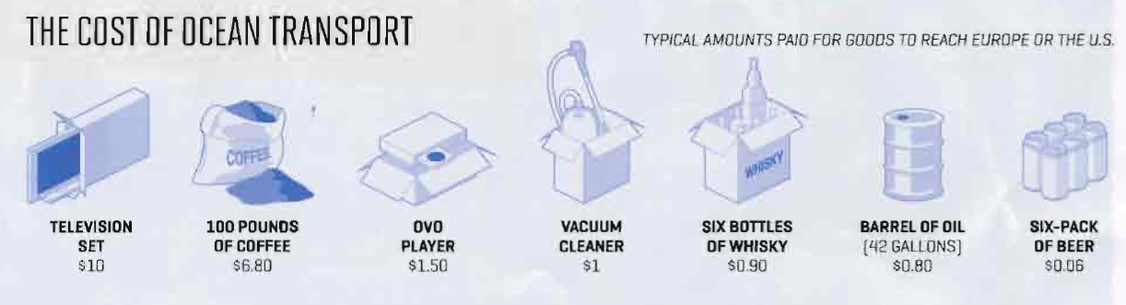
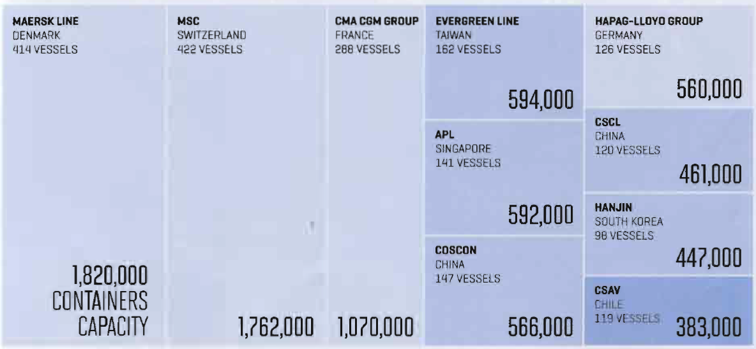
Shipping Cost (2011)
Top Container Operators (2011)
Source: Fortune, May 21, 2012

Slide 72
Potential Issues
Lack of Port Capacity
Long Lead Times
Holding cost (PS/SS)
Security & regulations
Panama canal expansion

Slide 73
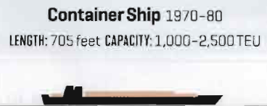
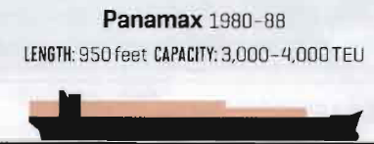
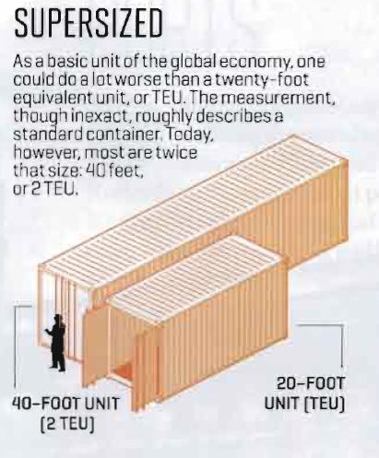
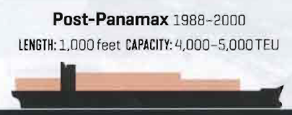
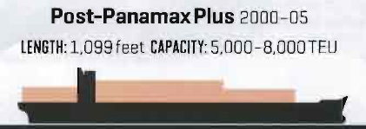
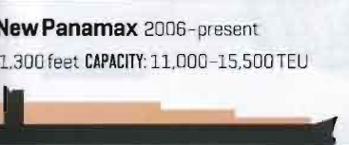

Cargo Ships
Source: Fortune, May 21, 2012

Slide 74
Transportation Modes
Trucks
Rail
Air
Package Carriers
Water
Pipeline
Notes:
74
Notes:

Slide 75
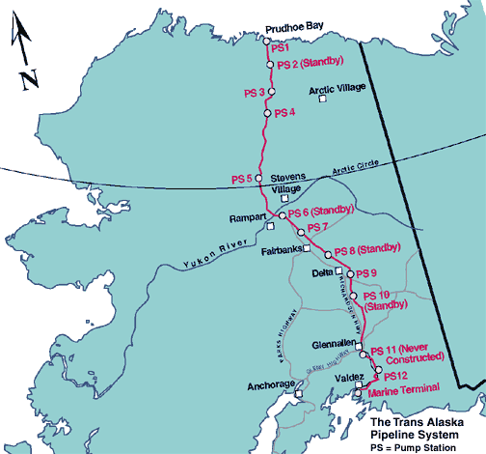
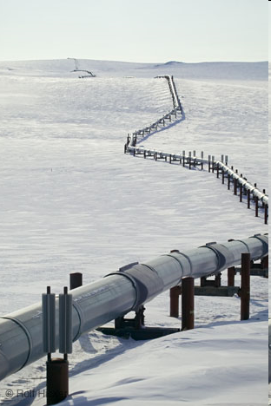
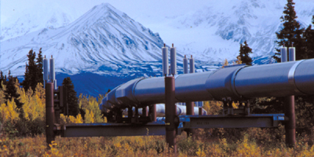
Pipeline
Slow, reliable
Standardized handling procedure
Key Issues
  Fixed cost
  High volume
  Special maintenance requirements

Slide 76
Transportation Modes
Trucks
Rail
Air
Package Carriers
Water
Pipeline
Notes:
76
Notes:

Slide 77
Intermodal Transportation
Use of more than one mode of transportation to move a shipment
Grown considerably with increased use of containers
May be the only option for global trade
Convenient for shippers
Key issue – exchange of information to facilitate transfer between different modes

Slide 78
Lecture Outline
SC Inventory Computations
Risk Pooling
Intro to Warehousing
Warehouse Technology
Intro to transportation (time permitting)
Summary

Slide 79
Summary & Key Takeaways
Inventory Management
  Models vs total SC inventory computations
  Which model?
  Total SC inventory
  Risk pooling
  All calculations!
Warehousing and Warehouse Technologies
  Warehouse economics & layout principles
  Business issues with barcode, RFID
Different transportation modes

Slide 80
Next Class:
Inventory Management - IIII
Transportation Planning
Read
  Case: HP DeskJet (eBook)
  P.74-77 and p.81-83 from eBook
  Review SOLVER PPT (or video if applicable)
  Your SCM 701 notes on SOLVER
HW 3 due at the beginning of class

